Slide 1

Basic of C Programming
Concepts of Data Types, keywords & others

Slide 2
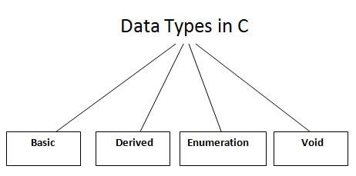

Data Types in C -
A data type specifies the type of data that a variable can store such as integer, floating, character etc.

Slide 3
Data Types in C -
There are the following data types in C language –
Types | Data Types
Basic or Primitive Data Types | int, char, float, double
Derived or Aggregate Data Types | array, pointer, structure, union
User defined Data Type | enum
Void Data Type | void

Slide 4

Data Types in C -
Basic Data Types –
The basic data types are integer-based and floating-point based. C language supports both signed and unsigned literals.
The memory size of the basic data types may change according to 32 or 64-bit operating system. Let's see the basic data types. Its size is given according to 32-bit architecture.
Note: All other data types will discuss later.

Slide 5
Data Types in C -
Data Types | Memory Size | Range
char | 1 byte | −128 to 127
int | 2 byte | −32,768 to 32,767
float | 4 byte | --
double | 8 byte | --

Slide 6
Keywords in C -
A keyword is a reserved word. You cannot use it as a variable name, constant name, etc.
There are only 32 reserved words (keywords) in the C language.

Slide 7
Keywords in C -
auto | break | case | char | const | continue | default | do
double | else | enum | extern | float | for | goto | if
int | long | register | return | short | signed | sizeof | static
struct | switch | typedef | union | unsigned | void | volatile | while

Slide 8
Comments in C -
Comments in C language are used to provide information about lines of code. It is widely used for documenting code. There are 2 types of comments in the C language –
Single Line Comments
Multi-Line Comments
- Single Line Comments – | - Multi Line Comments -
#include<stdio.h> void main() { //printing information printf("Hello C"); } | #include<stdio.h> void main() { /*printing information Multi-Line Comment*/ printf("Hello C"); }

Slide 9
Escape Sequence in C -
An escape sequence in C language is a sequence of characters that doesn't represent itself when used inside string literal or character.
It is composed of two or more characters starting with backslash \.
For example: \n represents new line.

Slide 10
Escape Sequence in C -
Escape Sequence | Meaning
\b | Backspace
\n | New Line
\t | Tab (Horizontal)
\v | Vertical Tab
\\ | Backslash
\' | Single Quote
\" | Double Quote
\? | Question Mark
\0 | Null

Slide 11
Thank you…

